Slide 1
Web Basics – HTML5
Lesson 6. Image Handling

Slide 2
Lesson Objectives
After completing this module, you will be able to:
  Understand the role of images in web pages
  Learn to add images to web pages
  Learn to use images as hyperlinks

Slide 3
6.1: Role of images in web pages
Roles of images in web pages
Web pages are comprised of text and images.
Some of the roles of images in web pages are
  To make web page content more interesting to be read
  To increase clarity on web page content by transmitting right message
  Provoking reactions
  To ensure that the user response is anticipated
Some of the widely used image formats
  GIF : Graphical Interchangeable Format
  JPEG : Joint Photographic Expert Group
  PNG : Portable Network Graphics
Notes:
GIF images are quickly downloadable, because its size is less. It is used for animated images, thumbnails, B/W image . It supports only 256 colors
JPEG images uses lossy compression method, meaning that some original image information is lost and cannot be restored, possibly affecting image quality.
PNG images are lossless, portable, well-compressed storage of raster images. It supports image transparency

Slide 4
6.2: Adding images in webpages
Adding images in webpages
Images are added into a HTML document using <img> tag.
<img> tag has 2 required attributes such as src and alt
Syntax:
The src attribute defines the url (web address) of the image
Alt attribute defines alternative text to display for non-graphical browsers. The alt attribute is required
Example:
<img src=“url” alt=“Alternate text”/>
<img src="html5.gif" alt="The official HTML5 Icon">
Notes:
GIF images are quickly downloadable, because its size is less. It is used for animated images, thumbnails, B/W image . It supports only 256 colors
JPEG images uses lossy compression method, meaning that some original image information is lost and cannot be restored, possibly affecting image quality.
PNG images are lossless, portable, well-compressed storage of raster images. It supports image transparency

Slide 5
6.2: Adding images in webpages
Attributes of an Inline Image
Other attributes of <img> tag are:
  width: Sets the width of the image.
  height: Sets the height of the image.
Notes:
GIF images are quickly downloadable, because its size is less. It is used for animated images, thumbnails, B/W image . It supports only 256 colors
JPEG images uses lossy compression method, meaning that some original image information is lost and cannot be restored, possibly affecting image quality.
PNG images are lossless, portable, well-compressed storage of raster images. It supports image transparency

Slide 6
6.2: Adding images in webpages
Text & Image Alignment (Code)
Style Attribute:
Can be used in <img> tag to define the alignment of text and image.
<br clear=LEFT/RIGHT> can be used to stop text flowing around an image
Style Attribute Value | Description
vertical-align:bottom | The bottom of the element is aligned with the lowest element on the line
vertical-align:middle | The element is placed in the middle of the parent element
vertical-align:top | The top of the element is aligned with the top of the tallest element on the line
float:right | The element floats to the left
float:left | The element floats to the right
float:none | The element floats to the none
Notes:
Insert the <br clear=LEFT/RIGHT> command at the spot in the descriptive text where text is to stop flowing around the image.

Slide 7
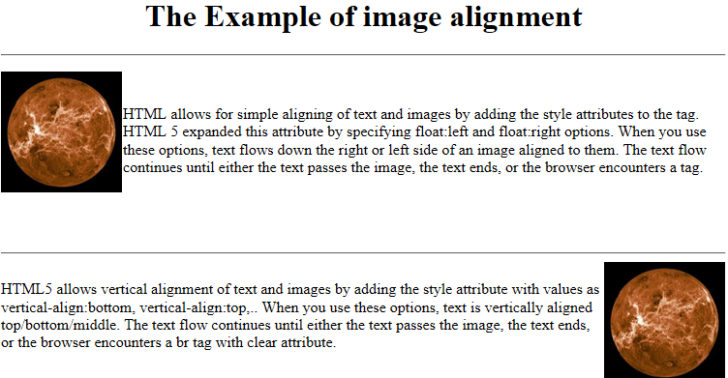
6.2: Adding images in webpages
Demo
ImageDemo.html
ImageAlign.html

Slide 8
6.3: Image as hyperlinks
Use of Image as a Hyperlink (Code)
Images used as hyperlinks:
<a href="6image1.html"><img src="home.gif"></a>
Images contained within a table:
<table>
<tr><th>Product</th><th>Cost</th><th>Image</th></tr>
<tr> <td>Pencil</td> <td>$8</td>
<td><img src="pencil.gif"></td> </tr>
<tr> <td>Brush</td> <td>$15</td>
<td><img src="paintbrush.gif"></td></tr></table>
Notes:
Use Image as Link
To create an image link, place the <img src> tag with the image URL between <a href=”URL”>……</a> tags.
<h2>MY FIRST IMAGE LINK</h2>
<a href=”BALLOON.HTM”><img src=”BALLOON.GIF”></a>Click on it to have
additional information on it.

Slide 9
6.3: Image as hyperlinks
Demo
ImageLink.html

Slide 10
Lab
Lab 5

Slide 11
Lesson Summary
In this lesson, you have learnt about:
  Role of images in web pages
  How to add images in web pages
  How to use images as hyperlinks

Slide 12
Review - Questions
Question 1: Client-side image maps are usually faster than server-side image maps.
  True/ False
Question 2: ____________ contain the linking information on the server.

